Slide 1
Welcome to the world of JSC English First paper
Multimedia Presentation
I am
Md Hasan Hafizur Rahman
Lecturer
Department of English
Cambrian School & College
Dhaka, going to conduct the class with you.

Slide 2
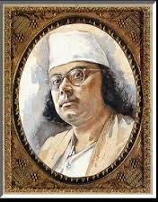
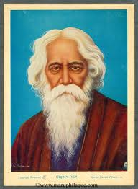
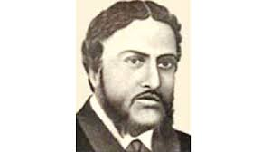
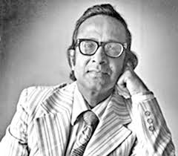
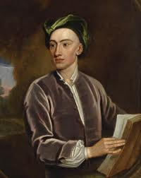
Let us introduce with some poets
But who is he?
Alexander Pope

Slide 3
Who is Alexander Pope
He is a great English poet

Slide 4
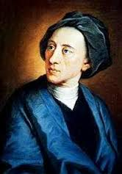
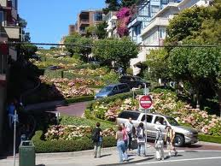
Was born on 21 May,
1688
at Lombard Street,
London

Slide 5
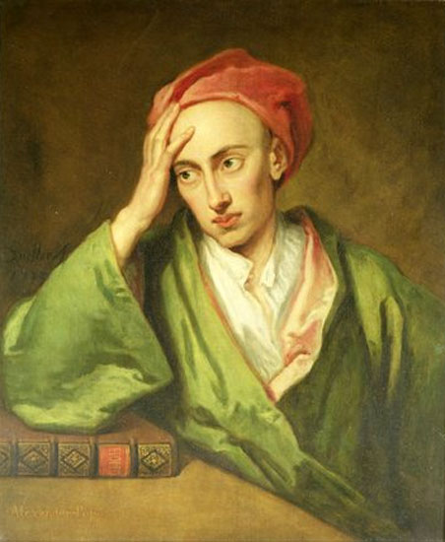
Famous works of the great poet
Pastorals- -1709
An Essay on Criticism-1711
The Critical Specimen-1711
Messiah -1712
The Rape of the Lock -1712,14,15
Winsor-Forest- -1713
Contribution of the Guardian-1713
The Iliad of Homer -1715-20
Ode on Solitude -1717
The Odyssey of Homer-1725-26

Slide 6
The poet breathed his last on May 30, 1744, at
Tw Ickenham. London.

Slide 7
Let us enjoy one of his works
Ode on Solitude
নিঃসঙ্গ জীবনের গান
Unit-3,Lesson-2

Slide 8
Learning outcomes
After we have studied this unit, we will be able to
read and understand texts through silent reading
listen information
ask and answer questions
write the answers to questions
recite a poem

Slide 9
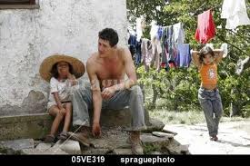
New words
Paternal
পৈত্রিক

Slide 10
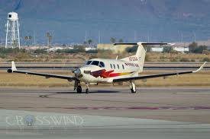
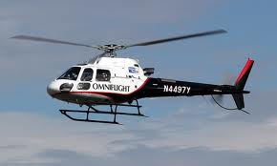
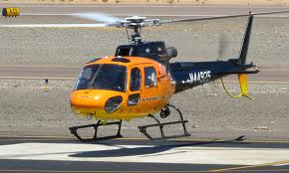
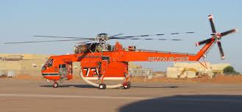
Native air-নিজ ভূমের হাওয়া

Slide 11
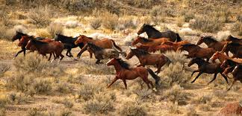
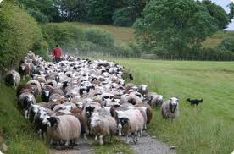
Flocks
ঝাঁকে ঝাঁকে/দল বেঁধে
ঘোড়া চলে দলে দলে
মেষ চলে আপন মনে

Slide 12
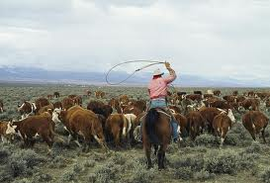
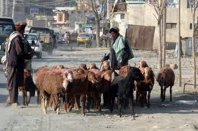
-cïcvjK
Herd

Slide 13
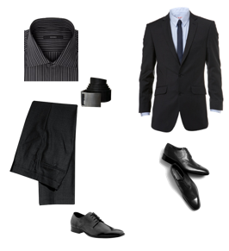

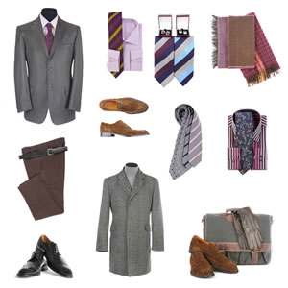
Attire
বেশভূষা/কাপড়-চোপড়

Slide 14
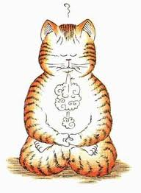
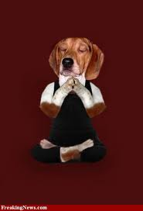
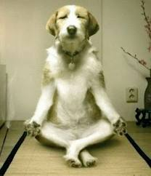
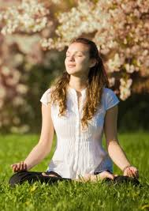
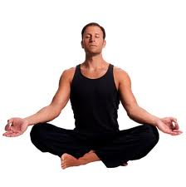
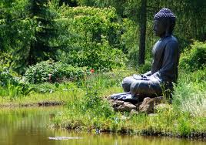
Meditation
-ধ্যান

Slide 15

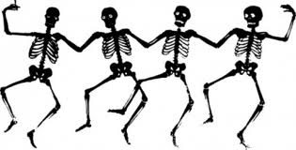
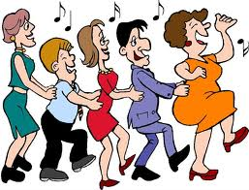

Sweet recreation
- মধূময় আনন্দ

Slide 16
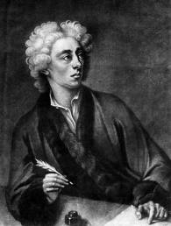
Ode on Solitude
Happy the man, whose wish and care
A few paternal acres bound,
Content to breathe his native air,
In his own ground.
Whose herds with milk, whose fields with bread,
Whose flocks supply him with attire,
Whose trees in summer yield him shade,
In winter fire.
Blest! who can unconcern'dly find
Hours, days, and years slide soft away,
In health of body, peace of mind,
Quiet by day,
Sound sleep by night; study and ease
Together mix'd; sweet recreation,
And innocence, which most does please,
With meditation.
Thus let me live, unseen, unknown;
Thus unlamented let me dye;
Steal from the world, and not a stone
Tell where I lie.
Alexander Pope

Slide 17
Group Work
Write down the name, address ,works and life history of Alexander
Pope to write a paragraph.

Slide 18
Evaluation
Who was Alexander Pope?
Where was he born?
What do you mean by Ode on Solitude?
Where did he want to pass his time?
How did he want to die?
Ans- Alexander Pope was a great English poet.
Ans-He was born in Lombard, London
Ans- It means passing time in a solitary place.
Ans-He wanted to pass his time in his paternal land.
Ans-He wanted an unlamented die.

Slide 19
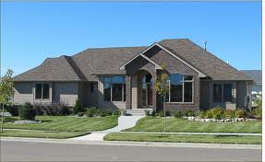
Task
Write what actually the poem
wanted to say in the poem
“Ode on Solitude।.”

Slide 20

বেঁজে উঠলো বাঁশি
আমি এখন আসি

